Slide 1
PUBLIC SCHOOL OFFER
FOR UKRAINIAN REFUGEES AND OTHER REFUGEES FROM UKRAINE IN LUXEMBOURG

Slide 2
Remarque préliminaire

Slide 3
Age 0-4

Slide 4
Age 4-6

Slide 5
Age 6-12

Slide 6
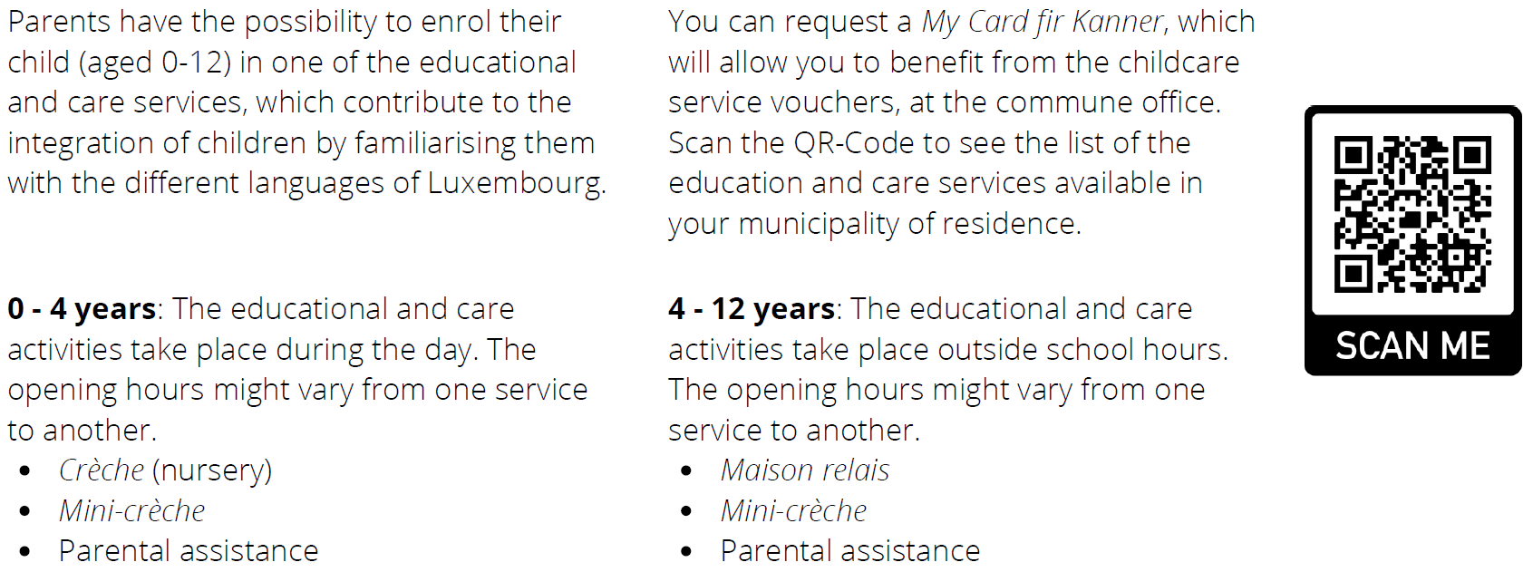
Educational and care services at preschool and primary school

Slide 7
Students with special needs

Slide 8
Age 12+

Slide 9
Age 17+

Slide 10
Formation des adultes

